Slide 1
Learn F# at an Easy Tempo
Eric Potter
Director of Technology Education,
Sweetwater
Notes:
Victor Hugo Pene (and Greg Lemond)
Simon Sinek – Why
Ron Fox, Tyler Silveus, Mark Braun

Slide 2
Intro to F#

Slide 3
What is F#?
A functional-first language for the .Net platform.

Slide 4
C#
F#
NuGet Packages
Base Class Library
Common Language Runtime (Executes MSIL)
Operating System (Windows, Mac, Linux, Android, iOS, etc)

Slide 5
TypeScript
F#
NPM Packages
DOM
JavaScript
JavaScript Engine (v8, SpiderMonkey, etc)

Slide 6
C#
F#
NuGet Packages
Base Class Library
Common Language Runtime (Executes MSIL)
Operating System (Windows, Mac, Linux, Android, iOS, etc)

Slide 7
F#
Compiler
F# Interactive
Common Language Runtime (Executes MSIL)

Slide 8
Benefits of F#?
F# empowers everyone to write succinct, robust and performant code
F# gives you simplicity and succinctness like Python with correctness, robustness and performance beyond C# or Java.

Slide 9
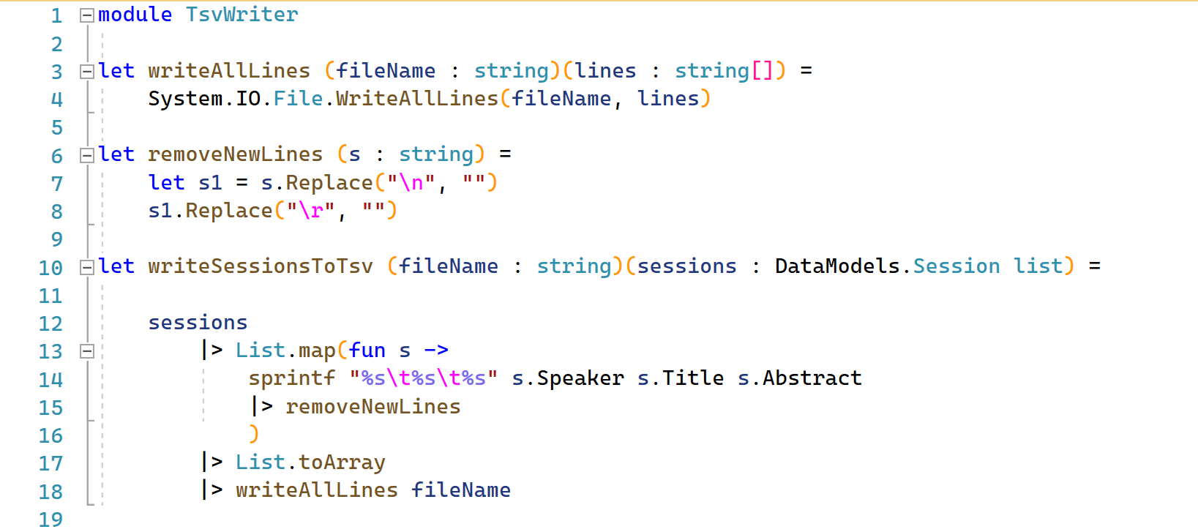

Slide 11
Concepts
Lists
List.iter
List.map
Notes:
Not the same as a System.Collections.Genereric.List
immutable

Slide 13
Demos
Notes:
Hello World
Fizz Buzz
Area of a Triangles

Slide 14
Exercises
Write a function to calculate the volume of a sphere given its radius.
Write a function that will categorize spheres given their radius. (v < 10: small; v < 100: medium; else: large
Write a function that will categorize all spheres with integer radius between 1 and 20.

Slide 15
Review
Notes:
Hello World
Fizz Buzz
Area of a Triangles

Slide 16
Questions
Why can F# easily integrate with C# apps and libraries?
What is it mean that F# has meaningful white space?
What keyword is used to define functions and variables?

Slide 17
Intro to Functional Programming

Slide 18
"OO makes code understandable by encapsulating moving parts. FP makes code understandable my minimizing moving parts"
- Michael Feathers

Slide 19
"In mathematics, a function is a relation between a set of inputs and a set of permissible outputs with the property that each input is related to exactly one output. An example is the function that relates each real number x to its square x². The output of a function f corresponding to an input x is denoted by f(x) (read "f of x"). In this example, if the input is −3, then the output is 9, and we may write f(−3) = 9. Likewise, if the input is 3, then the output is also 9, and we may write f(3) = 9. (The same output may be produced by more than one input, but each input gives only one output.) The input variable(s) are sometimes referred to as the argument(s) of the function."

Slide 20
"In mathematics, a function is a relation between a set of inputs and a set of permissible outputs with the property that each input is related to exactly one output. An example is the function that relates each real number x to its square x². The output of a function f corresponding to an input x is denoted by f(x) (read "f of x"). In this example, if the input is −3, then the output is 9, and we may write f(−3) = 9. Likewise, if the input is 3, then the output is also 9, and we may write f(3) = 9. (The same output may be produced by more than one input, but each input gives only one output.) The input variable(s) are sometimes referred to as the argument(s) of the function."
…each input is related to exactly one output.

Slide 21
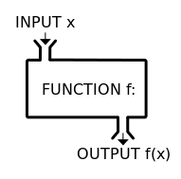

Slide 22
Themes of Functional Programming
Tame Side Effects
Expression Based
Treat Functions as Data

Slide 23
Concepts
Records

Slide 24


Slide 25
Concepts
Immutability
Pass State

Slide 26
State
Behavior
Behavior

Slide 27
Class
State A
State B
State C
Behavior A
Behavior B
Notes:
OO behavior and state

Slide 28
State A
Behavior A
State B
Behavior B
State C
Notes:
OO behavior and state

Slide 29
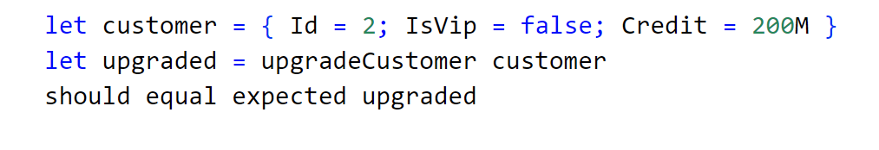
customer
upgradeCustomer
customer
|>
Should equal
result
Notes:
OO behavior and state

Slide 30
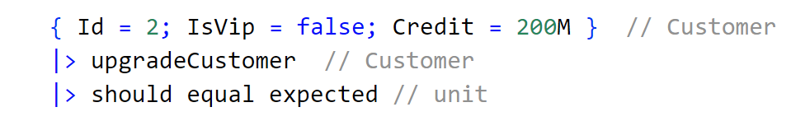
customer
upgradeCustomer
customer
|>
Should equal
result
Notes:
OO behavior and state

Slide 31
Concepts
Pure Functions

Slide 32
Class
Class
State A
State A
State B
State B
State C
State C
Behavior A
Behavior A
Behavior B
Behavior B
Notes:
In OO, member functions often use the state of the object. The state doesn’t come in as a parameter.

Slide 33
Class
Class
State A
State A
State B
State B
State C
State C
Behavior A
Behavior A
Behavior B
Behavior B
Notes:
You can have pure functions in OO.
Often you should.

Slide 34
Display
State A
Behavior A
State B
File System
Database
Notes:
Functional languages can have side effects too.

Slide 35
State A
Behavior A
State B
Notes:
Functional languages can have side effects too.

Slide 36
Demos
Notes:
Person Type
Euler 1

Slide 37
Exercises
Write a function that will take a list of integers and return the sum of the squares of the even numbers.
Write a function that will take a url as a string and if it starts with “https://”, remove it. (Ex: “https://sample.com” become “sample.com”)
Do the same of “http://”.
Write a function that will remove the query string from a url.
Write a function that will remove “http://”, “https://”, and the query string.

Slide 38
Review
Notes:
TBD

Slide 39
Questions
What makes a pure function pure?
What does the pipe forward operator do?

Slide 40
Exercises
Find the smallest number that can be divided by each of the numbers from 1 to 10 without any remainder. (hint: List.forall, List.find)
Write a function that calculates BMI.
Accept height in meters and weight in kilograms. Caluclate BMI as weight / height.
Output a message: underweight (BMI >= 25), overweight (BMI < 18.5) or healthy.
Keep the pure and impure parts of your code separate.
Notes:
This is a flex exercise. Do it if it isn’t 3:00 yet.

Slide 41
F# Goodness

Slide 42
Concepts
F# Projects

Slide 43
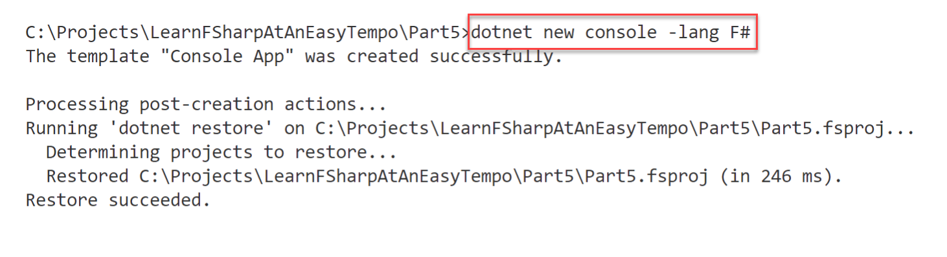

Slide 44
Concepts
Pattern Matching

Slide 45
switch
is / as
TryParse / regex
Pattern Matching

Slide 46
Selection
Assignment
Evaluation
Pattern Matching

Slide 47
Concepts
Type Providers
dotnet add package FSharp.Data

Slide 48
Demos
Notes:
Users.csv

Slide 49
Exercises
Using the Courses.csv file in the Part 6 folder, print the list of users that completed courses
Create a new console application
Install the FSharp.Data package.

Slide 50
Review
Notes:
TBD

Slide 51
Questions
TBD??

Slide 52
F# Libraries

Slide 53


Slide 54
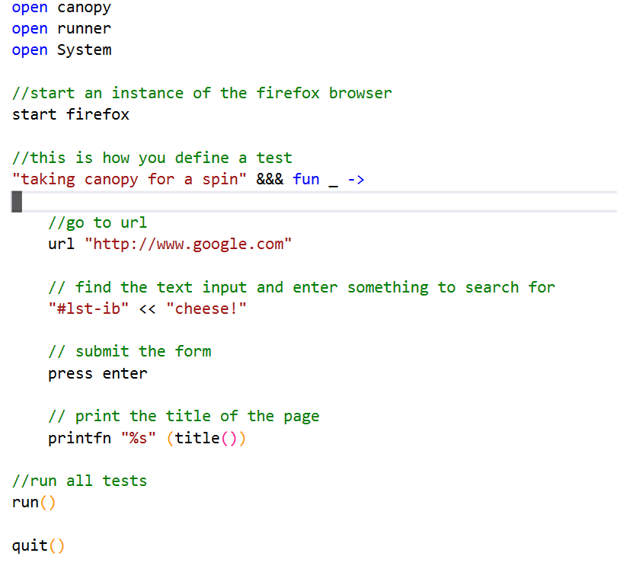

Slide 55


Slide 56

Notes:
Saturn model for server-side web programming
Azure for cloud-based systems
Fable for Javascript-enabled applications
Elmish for an easy-to-understand UI programming model

Slide 57
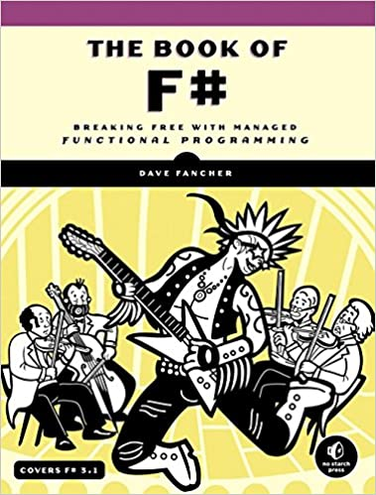
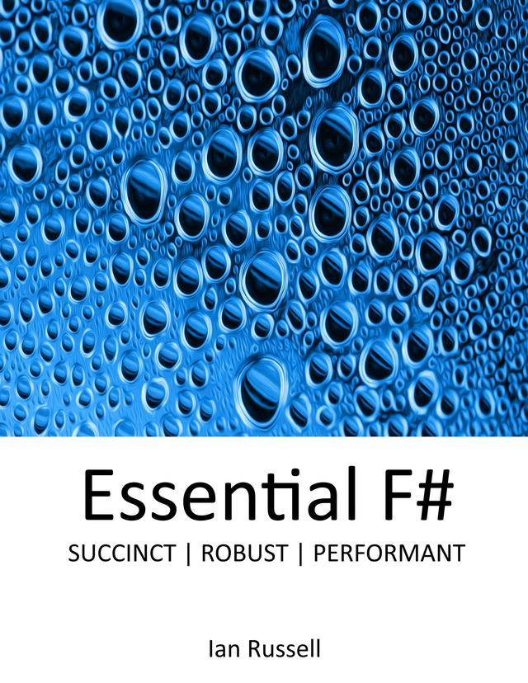

Slide 58
Thank You.
Let’s Chat Later.
@pottereric HumbleToolsmith.com

Slide 59
Demos
Notes:
TBD

Slide 60
Exercises
TBD
TBD

Slide 61
Review
Notes:
TBD

Slide 62
Questions
TBD??

Slide 63
<quote>

Slide 64
<Section Header>

Slide 65
<Section Header>

Slide 67
<Conclusion>

Slide 68
Title
Content 1

